Slide 1

EdYoda Digital University:
Python
EDYODA

Slide 2
Modules For week - 1
Environment Setup & Python Basics
Operators & Conditional Statement
Looping Statement
Python Strings

Slide 3
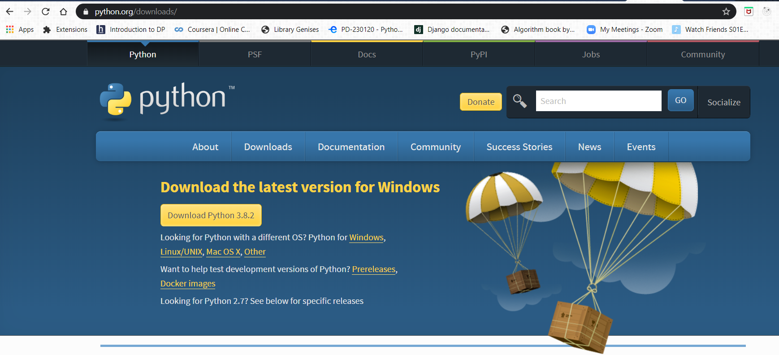
Environment Setup & Python Basics
Download Python -> https://www.python.org/downloads/
Essential Python for Data Science
https://www.edyoda.com

Slide 4
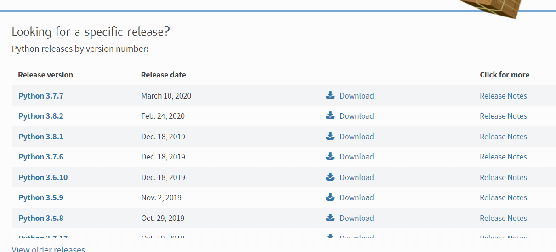
Environment Setup & Python Basics
For downloading different version.
Essential Python for Data Science
https://www.edyoda.com

Slide 5
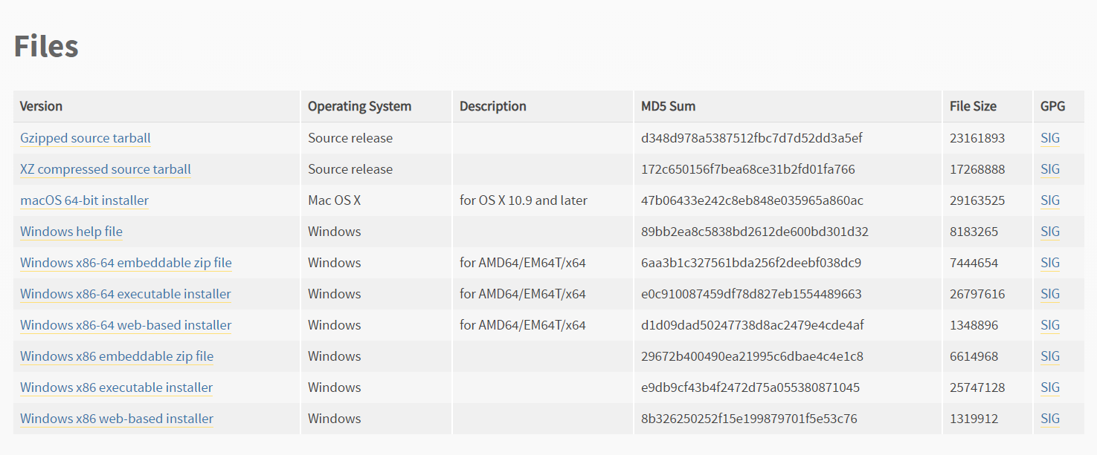
Environment Setup & Python Basics
Click on download button specific to version. Then download file from here as per your system.
Essential Python for Data Science
https://www.edyoda.com

Slide 6
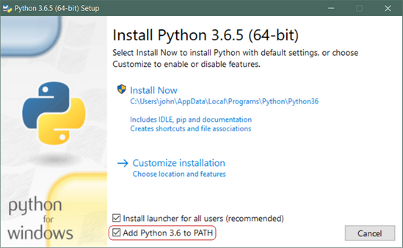
Environment Setup & Python Basics
Installation Process: click on add python x.x to path.
Essential Python for Data Science
https://www.edyoda.com

Slide 7

Environment Setup & Python Basics
Verify python installation.
Execute command python --version
Essential Python for Data Science
https://www.edyoda.com

Slide 8
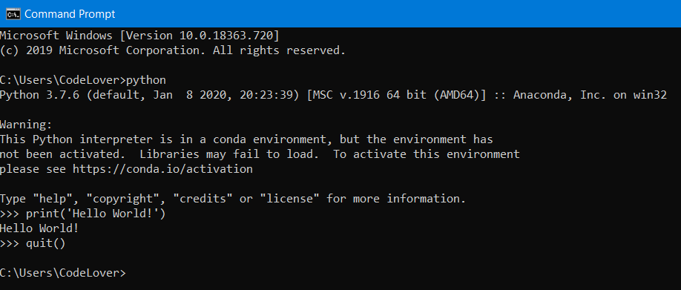
Environment Setup & Python Basics
Execution Mode:
1. Interactive Mode:
Open command prompt
Execute command: python
You should see >>> signs
To exit this python editor
execute command : quit()
Essential Python for Data Science
https://www.edyoda.com

Slide 9
Environment Setup & Python Basics
2.Scripting Mode:
File extension must be .py. E.g. test.py, index.py etc.
Open command prompt
Execute command to execute python script: python filename.py
3. IDE: Jupyter, Sublime, PyCharm, Atom, VSCode
Jupyter:
1. Command mode: Blue
2. Edit Mode: Green
3. Execute a cell: ctrl + enter
4. Execute a cell and add new cell: alt + enter
Essential Python for Data Science
https://www.edyoda.com

Slide 10
Environment Setup & Python Basics
Hello World! Program in python
print(“Hello World!”)
Assigning values to variables
a = 5
b = “Edyoda”
c, d = 3, 4
Essential Python for Data Science
https://www.edyoda.com

Slide 11
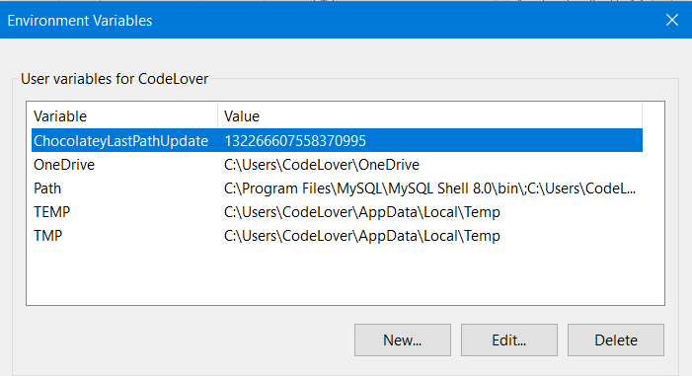
Environment Setup & Python Basics
Manually add Python to Windows Path
Step-1: Get to the Windows Environment Variables screen.
Search Edit environment variables for your account and open it.
Essential Python for Data Science
https://www.edyoda.com

Slide 12
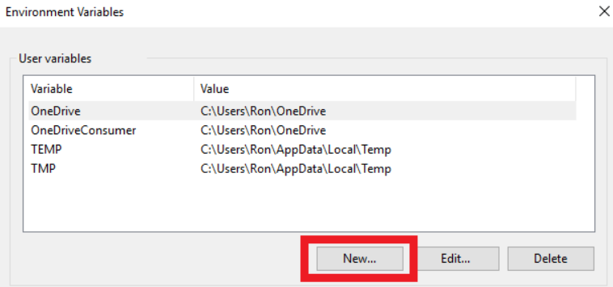
Environment Setup & Python Basics
Step-2: Click on ‘New…‘ which is located under the User variables box.
Essential Python for Data Science
https://www.edyoda.com

Slide 13
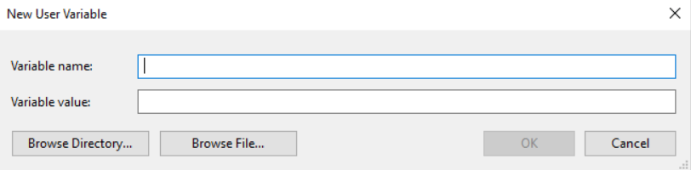
Environment Setup & Python Basics
You should then see the following box, which will allow you to add new variables
Essential Python for Data Science
https://www.edyoda.com

Slide 14
Environment Setup & Python Basics
The Python application path, which is the folder where you originally installed Python.
The Python Scripts path. The Scripts folder should be located within the Python application path.
Your path should look like this:
Python application path: C:\Users\Ron\AppData\Local\Programs\Python\Python37-32
Python Scripts path:
C:\Users\Ron\AppData\Local\Programs\Python\Python37-32\Scripts
Essential Python for Data Science
https://www.edyoda.com

Slide 15
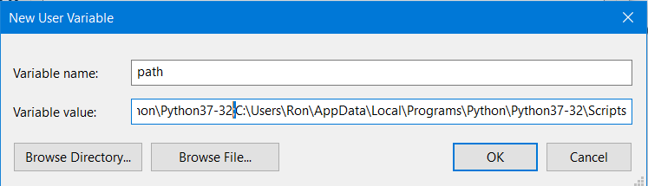
Environment Setup & Python Basics
Put the values of application and scripts path separated by “;”
Press OK
Essential Python for Data Science
https://www.edyoda.com

Slide 16
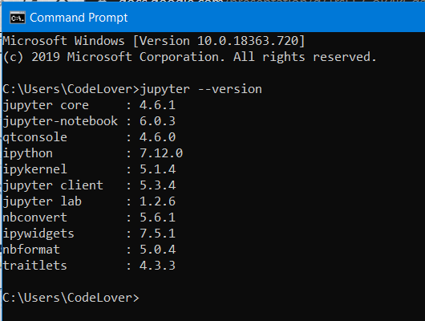
Environment Setup & Python Basics
Installing Jupyter Notebook:
Execute command -- “pip install jupyter”
For verification that jupyter notebook is installed or not execute command -- “jupyter --version”
Output should look like this
Essential Python for Data Science
https://www.edyoda.com

Slide 17
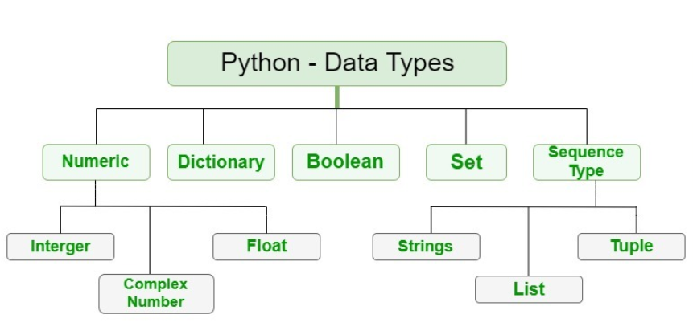
Python Data Types
Essential Python for Data Science
https://www.edyoda.com

Slide 18
Python Data Types
1. Integer- It contains positive or negative whole numbers (without fraction or decimal). In Python there is no limit to how long an integer value can be. e.g. 25, b = 100.
2. Float- It is a real number with floating point representation. It is specified by a decimal point. e.g. 100.0
3. String- In Python, Strings are arrays of bytes representing Unicode characters. A string is a collection of one or more characters put in a single quote, double-quote or triple quote. In python there is no character data type, a character is a string of length one. e.g. ‘edyoda’ , ‘This is a string’.
Essential Python for Data Science
https://www.edyoda.com

Slide 19
Python Data Types
4. List- Lists are just like the arrays, declared in other languages. Lists need not be homogeneous always which makes it the most powerful tool in Python. The elements in a list are indexed according to a definite sequence and the indexing of a list is done with 0 being the first index. e.g. [1, 2, 3, ‘abc’, 25.0]
5. Tuple- In Python, tuples are created by placing sequence of values separated by ‘comma’ with or without the use of parentheses for grouping of data sequence. e.g. (1, 2, 1, abc, 5)
Essential Python for Data Science
https://www.edyoda.com

Slide 20
Python Data Types
6. Dictionary- Dictionary in Python is an unordered collection of data values, used to store data values like a map.Dictionary holds Key:Value pair e.g. {‘name’: ‘abc’, ‘roll no’: 123}
7. Sets- In Python, Set is an unordered collection of data type that is iterable, mutable and has no duplicate elements. e.g. (1, 2, 3, 4)
8.Boolean- Data type with one of the two built-in values True or False. Boolean objects that are equal to True are truthy (true), and those equal to False are falsy (false). e.g. check = True, print(True)
Essential Python for Data Science
https://www.edyoda.com

Slide 21
Python Data Types COnversion
Python defines type conversion functions to directly convert one data type to another which is useful in day to day and competitive programming. This article is aimed at providing the information about certain conversion functions.
1. int(a,base) : This function converts any data type to integer. ‘Base’ specifies the base in which string is if data type is string.
2. float() : This function is used to convert any data type to a floating point number.
3. ord() : This function is used to convert a character to integer.
4. hex() : This function is to convert integer to hexadecimal string.
5. oct() : This function is to convert integer to octal string.
Essential Python for Data Science
https://www.edyoda.com

Slide 22
Python Data Types Conversion
6. tuple() : This function is used to convert to a tuple.
7. set() : This function returns the type after converting to set.
8. list() : This function is used to convert any data type to a list type.
9. dict() : This function is used to convert a tuple of order (key,value) into a dictionary.
10. str() : Used to convert integer into a string.
11. complex(real,imag) : : This function converts real numbers to complex(real,imag) number.
e.g. num = 100
print(str(num))
Output: ‘100’
Essential Python for Data Science
https://www.edyoda.com

Slide 23
Operators & Conditional Statement
Operators –
Arithmetic operators: +, -, *, /(true division), //(floor division), %(mod), ** (pow)
2. Comparison operators: ==, !=, <, >, <=, >=, True/False
3. Membership operators: in & not in
4. Identity operators: is & is not
5. Logical operators: and, or & not
6. Assignment Operators: =, +=, -= , /=
Essential Python for Data Science
https://www.edyoda.com

Slide 24
Operators & Conditional Statement
Conditional Statements: Conditional Statement in Python perform different computations or actions depending on whether a specific Boolean constraint evaluates to true or false. Conditional statements are handled by IF statements in Python.
1. If-else statement: In Python, If Statement is used for decision making. It will run the body of code only when IF statement is true.
e.g. if (condition):
statements
else:
statements
Essential Python for Data Science
https://www.edyoda.com

Slide 25
Operators & Conditional Statement
2. Nested If-elif-else statement: By using "elif" condition, you are telling the program to print out the third condition or possibility when the other condition goes wrong or incorrect.
e.g. if (condition-1):
statements
elif (condition-2):
statements
else:
statements
Essential Python for Data Science
https://www.edyoda.com

Slide 26
Operators & Conditional Statement
Indentation:
A block is a combination of all these statements. Block can be regarded as the grouping of statements for a specific purpose. Most of the programming languages like C, C++, Java use braces { } to define a block of code. One of the distinctive features of Python is its use of indentation to highlight the blocks of code. Whitespace is used for indentation in Python.
All statements with the same distance to the right belong to the same block of code. If a block has to be more deeply nested, it is simply indented further to the right. You can understand it better by looking at the following lines of code:
Essential Python for Data Science
https://www.edyoda.com

Slide 27
Operators & Conditional Statement
e.g.
#indentation level 0
if (condition1):
#indentation level 1
statements
if (condition2):
#indentation level 2
statements
#again indentation level 1
statements
#again indentation level 0
statements
Essential Python for Data Science
https://www.edyoda.com

Slide 28
Looping Statements
1. For loop: For loops are used for sequential traversal.
e.g. for [user_defined_vatiable] in [iterable_datatype]:
# code inside for loop
statements
# code outside for loop
Code:
List = [1,2,3]
for i in list:
print(i)
Output:
1
2
3
Essential Python for Data Science
https://www.edyoda.com

Slide 29
Looping Statements
2. While loop: while loop is used to execute a block of statements repeatedly until a given a condition is satisfied. And when the condition becomes false, the line immediately after the loop in program is executed.
e.g. while (condition):
# code inside while loop if condition is true
statements
# code outside while loop when condition is false
Code:
count = 0
while (count<2):
print(count)
count += 1
Output:
0
1
Essential Python for Data Science
https://www.edyoda.com

Slide 30
Looping Statements
3. Nested loop:
Nested loop means using another loop inside a loop.
e.g. while (condition):
# code inside while loop if condition is true
for [user_defined_vatiable] in [iterable_datatype]:
# this for loop is a nested loop inside a while loop
statements #inside for loop
statements # outside for loop and inside while loop
# code outside while loop when condition is false
Essential Python for Data Science
https://www.edyoda.com

Slide 31
Looping Statements
4. Break statement:
The break statement is used to terminate the loop. After that, the control will pass to the statements that are present after the loop, if available. If the break statement is present in the nested loop, then it terminates only those loops which contains break statement.
Syntax:
for [user_defined_vatiable] in [iterable_datatype]:
statements
some conditions:
break
Essential Python for Data Science
https://www.edyoda.com

Slide 32
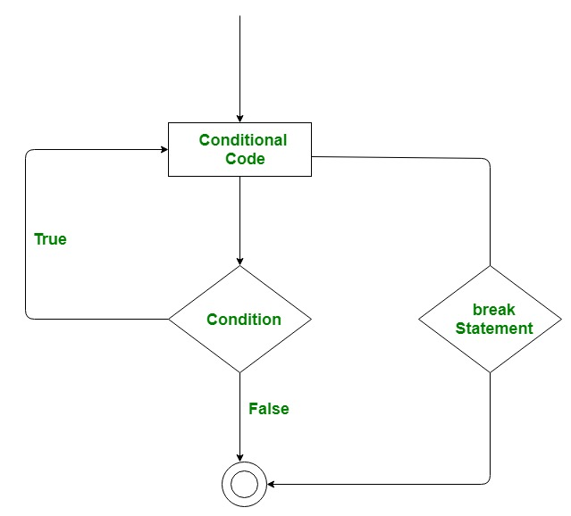
Looping Statements
Essential Python for Data Science
https://www.edyoda.com

Slide 33
Looping Statements
4. Continue statement:
Continue is also a loop control statement just like the break statement. continue statement is opposite to that of break statement, instead of terminating the loop, it forces to execute the next iteration of the loop.
When the continue statement is executed in the loop, the code inside the loop following the continue statement will be skipped and the next iteration of the loop will begin.
Syntax:
for [user_defined_vatiable] in [iterable_datatype]:
statements
some conditions:
continue
Essential Python for Data Science
https://www.edyoda.com

Slide 34
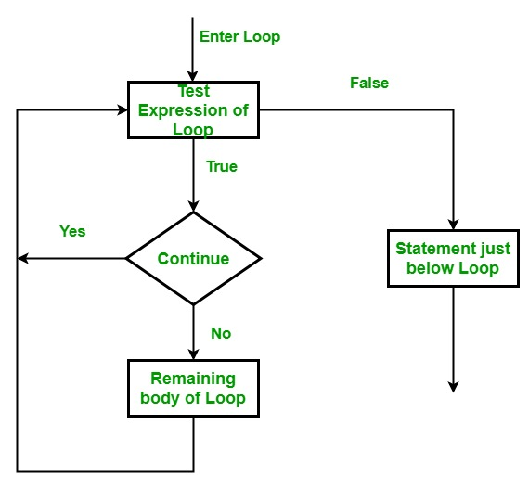
Looping Statements
Essential Python for Data Science
https://www.edyoda.com

Slide 35
Looping Statements
4. Pass statement:
As the name suggests pass statement simply does nothing. The pass statement in Python is used when a statement is required syntactically but you do not want any command or code to execute. It is like null operation, as nothing will happen is it is executed. Pass statement can also be used for writing empty loops. Pass is also used for empty control statement, function and classes.
Syntax:
for [user_defined_vatiable] in [iterable_datatype]:
pass
Essential Python for Data Science
https://www.edyoda.com

Slide 36
Looping Statements
4. Else block:
As you have learned before, the else clause is used along with the if statement. Python allows the else keyword to be used with the for and while loops too. The else block appears after the body of the loop. The statements in the else block will be executed after all iterations are completed. The program exits the loop only after the else block is executed.
Syntax:
for [user_defined_vatiable] in [iterable_datatype]:
statement # inside for loop
else:
#else block
#outside loop
Essential Python for Data Science
https://www.edyoda.com

Slide 37
Looping Statements
4. Range Function:
In simple terms, range() allows user to generate a series of numbers within a given range. Depending on how many arguments user is passing to the function, user can decide where that series of numbers will begin and end as well as how big the difference will be between one number and the next.range() takes mainly three arguments.
start: integer starting from which the sequence of integers is to be returned
stop: integer before which the sequence of integers is to be returned. The range of integers end at stop – 1.
step: integer value which determines the increment between each integer in the sequence
Essential Python for Data Science
https://www.edyoda.com

Slide 38
Looping Statements
4. Enumerate Function:
A lot of times when dealing with iterators, we also get a need to keep a count of iterations. Python eases the programmers’ task by providing a built-in function enumerate() for this task.
Enumerate() method adds a counter to an iterable and returns it in a form of enumerate object. This enumerate object can then be used directly in for loops or be converted into a list of tuples using list() method.
Syntax: enumerate(iterable, start)
Parameters:
i) Iterable: any object that support iteration
ii) start: the index value from which the counter is to be start by default it is 0.
Essential Python for Data Science
https://www.edyoda.com

Slide 39
Data Types
1. Int 1. List
2. Float 2. Set
3. Str 3. Dictionary
4. Tuple
Data Types
Immutable Data Types
(python will provide methods to perform add/update delete operation )
Mutable Data Types
(No method to perform add/update/delete operation)
Essential Python for Data Science
https://www.edyoda.com

Slide 40
Data Types
1. String:
A string is a sequence of characters. It can be declared in python by using double quotes. Strings are ordered(indexing and slicing operations can be perform).Strings are immutable, i.e., they cannot be changed.
e.g. a = “This is a string.”
Operations on string:
1. lower() : Converts the string in lowercase.
e.g. a.lower() // output: ‘this is a string’
2. Upper() : Converts the string in uppercase.
e.g. a.upper() // output: ‘THIS IS A STRING’
Essential Python for Data Science
https://www.edyoda.com

Slide 41
Data Types
3. isupper()/islower() : This gives true/false according to case of string lower or upper.
4. index() : Gives the index value of parameter passed in function.
5. replace() : Replaces a word/letter in string.
e.g. variable_name.replace(“old:str”,”new:str”)
6. format() : We can use format function for formatting string in print statement .
e.g.
num1 = 50
print(“Value of num1 is {}”.format(num1))
For more such functions prefer python docs.
Link => https://docs.python.org/3/library/stdtypes.html#string-methods
Essential Python for Data Science
https://www.edyoda.com

Slide 42
Modules For week - 2
List and Tuple
Dict
Set | Math & Random
User defined functions
User defined functions | Modules | Packages

Slide 43
Data Types
2. List:
Lists are mutable sequences, typically used to store collections of heterogeneous items. Lists are ordered means indexing and slicing.
e.g. l = [1, 2, 3, “abc”, [0, 1], {‘name’:’abc’, ’roll no’:123}, (a, b, c)]
Operations on list:
1. Add : To add item in a list.
i) append(): To add an item at the end of list.
e.g. l.append(item)
ii) extend(): To add many items at the end of list.
e.g. l.extend(item1,item2..etc.)
Essential Python for Data Science
https://www.edyoda.com

Slide 44
Data Types
iii) insert(): insert an item at given index.
e.g. l.insert(index_value, item)
2. Update: To update or replace items in a list.
e.g. l[index] = new_value
3. Delete: To remove an item/element from list.
i) delete(index_value): To remove an item from a given index value.
ii) remove(item): To remove a specific item.
iii) clear(): To remove/delete all element from list.
For more such functions prefer python docs.
Link 🡪 https://docs.python.org/3/library/stdtypes.html#sequence-types-list-tuple-range
Essential Python for Data Science
https://www.edyoda.com

Slide 45
Data Types
3. Tuple:
A tuple is a sequence of immutable(can not update/change values in it) Python objects. Tuples are sequences, just like lists. The differences between tuples and lists are, the tuples cannot be changed unlike lists and tuples use parentheses, whereas lists use square brackets.
Creating a tuple is as simple as putting different comma-separated values. Optionally you can put these comma-separated values between parentheses also.
e.g. t = (‘physics’, 50)
NOTE: Tuples are ordered(indexing and slicing operations can be perform)
Essential Python for Data Science
https://www.edyoda.com

Slide 46
Data Types
4. Dictionary:
dictionaries are indexed by keys, which can be any immutable type; strings and numbers can always be keys. Tuples can be used as keys if they contain only strings, numbers, or tuples; if a tuple contains any mutable object either directly or indirectly, it cannot be used as a key. You can’t use lists as keys, since lists can be modified in place using index assignments, slice assignments, or methods like append() and extend().
It is best to think of a dictionary as a set of key: value pairs, with the requirement that the keys are unique (within one dictionary).
e.g. d = {‘name’:’abc’, ‘roll number’: 123}
Essential Python for Data Science
https://www.edyoda.com

Slide 47
Data Types
my_dict = {'name':'Jack', 'age': 26}
Access dictionary elements:
print(my_dict[‘name’])
Update key values:
my_dict[‘name’] = ‘David’
Delete a particular key:
del my_dic[‘age’]
Delete/clear all elements:
my_dict.clear()
Essential Python for Data Science
https://www.edyoda.com

Slide 48
Data Types
Dictionary Methods:
clear(): Remove all items from the dictionary.
copy(): Return a shallow copy of the dictionary.
fromkeys(seq[, v]): Return a new dictionary with keys from seq and value equal to v (defaults to None).
get(key[,d]): Return the value of key. If key does not exist, return d (defaults to None).
items(): Return a new view of the dictionary's items (key, value).
keys(): Return a new view of the dictionary's keys.
pop(key[,d]): Remove the item with key and return its value or d if key is not found. If d is not provided and key is not found, raises KeyError.
Essential Python for Data Science
https://www.edyoda.com

Slide 49
Data Types
8. popitem(): Remove and return an arbitary item (key, value). Raises KeyError if the dictionary is empty.
9. setdefault(key[,d]): If key is in the dictionary, return its value. If not, insert key with a value of d and return d (defaults to None).
10. update([other]): Update the dictionary with the key/value pairs from other, overwriting existing keys.
11. values(): Return a new view of the dictionary's values
Essential Python for Data Science
https://www.edyoda.com

Slide 50
Data Types
5. Set:
A set is a collection which is unordered and unindexed. In Python sets are written with curly brackets.
e.g. set = {"apple", "banana", "cherry"}
NOTE: Sets are unordered, so you cannot be sure in which order the items will appear.
You cannot access items in a set by referring to an index, since sets are unordered the items has no index.Once a set is created, you cannot change its items, but you can add new items. To add one item to a set use the add() method.To add more than one item to a set use the update() method.
Essential Python for Data Science
https://www.edyoda.com

Slide 51
Data Types
Operations:
Union: Gives all element from both sets without repetition.
Intersection: Gives only common element from both sets.
Difference: Gives element of 1st set which are not present in 2nd set.
Symmetric Difference: Gives all those elements which are not common
e.g. A = {0, 2, 4, 6, 8}, B = {1, 2, 3, 4, 5}
Union : [0, 1, 2, 3, 4, 5, 6, 8]
Intersection : [2, 4]
Difference : [8, 0, 6]
Symmetric difference : [0, 1, 3, 5, 6, 8]
Essential Python for Data Science
https://www.edyoda.com

Slide 52
Data Types
Math Module:
This module provides access to the mathematical functions defined by the C standard.
These functions cannot be used with complex numbers; use the functions of the same name from the cmath module if you require support for complex numbers. The distinction between functions which support complex numbers and those which don’t is made since most users do not want to learn quite as much mathematics as required to understand complex numbers.
for more math function visit here:
https://docs.python.org/3/library/math.html
Essential Python for Data Science
https://www.edyoda.com

Slide 53
Data Types
Random Module:
This module implements pseudo-random number generators for various distributions. For integers, there is uniform selection from a range. For sequences, there is uniform selection of a random element, a function to generate a random permutation of a list in-place, and a function for random sampling without replacement.On the real line, there are functions to compute uniform, normal (Gaussian), lognormal, negative exponential, gamma, and beta distributions. For generating distributions of angles, the von Mises distribution is available.
for more random function visit here:
https://docs.python.org/3/library/random.html
Essential Python for Data Science
https://www.edyoda.com

Slide 54
Function
A function is a block of organized, reusable code that is used to perform a single, related action. Functions provide better modularity for your application and a high degree of code reusing.
As you already know, Python gives you many built-in functions like print(), etc. but you can also create your own functions. These functions are called user-defined functions.
Syntax:
def function_name(arguments):
# write all your code here
# outside of function
Essential Python for Data Science
https://www.edyoda.com

Slide 55
User Defined Functions
Defining a Function:
You can define functions to provide the required functionality. Here are simple rules to define a function in Python.
Function blocks begin with the keyword def followed by the function name and parentheses ( ).
Any input parameters or arguments should be placed within these parentheses.
The code block within every function starts with a colon (:) and is indented.
The statement return [expression] exits a function.
Essential Python for Data Science
https://www.edyoda.com

Slide 56
User Defined Functions
Scope of Variable:
Global variables are the one that are defined and declared outside a function and we need to use them inside a function. Local variables are defined inside a function.
e.g.
a = “this is a global variable”
def local():
b = “this is a local variable”
print(a) # we can use a inside/outside function
print(a) # we cannot use b outside the function
Essential Python for Data Science
https://www.edyoda.com

Slide 57
User Defined Functions
using global keyword we can make a local variable global.
e.g.
def func_name():
global b
b = ‘This is a local varibale without ‘global b’ statement but now it is global varibale ”
#outside the func we can use b
print(b)
Essential Python for Data Science
https://www.edyoda.com

Slide 58
Function
*args :
The special syntax *args in function definitions in python is used to pass a variable number of arguments to a function. It is used to pass a non-keyworded, variable-length argument list.
e.g.
def myFun(*argv):
for arg in argv:
print (arg)
myFun(‘Hello’, ‘Welcome’, ‘to’, ‘Edyoda’)
Essential Python for Data Science
https://www.edyoda.com

Slide 59
Function
**kwargs :
The special syntax **kwargs in function definitions in python is used to pass a keyworded, variable-length argument list. We use the name kwargs with the double star. The reason is because the double star allows us to pass through keyword arguments
e.g.
def myFun(**kwargs):
for key, value in kwargs.items():
print ("%s == %s" %(key, value))
myFun(first ='assessments', mid ='edyoda', last='com')
Essential Python for Data Science
https://www.edyoda.com

Slide 60
Function
Recursive Functions:
he process in which a function calls itself directly or indirectly is called recursion and the corresponding function is called as recursive function. Using recursive algorithm, certain problems can be solved quite easily. Examples of such problems are Towers of Hanoi (TOH), Inorder/Preorder/Postorder Tree Traversals, DFS of Graph, etc.
e.g.
def factorial(num):
if num ==1:
return 1
else:
return (num*factorial(num-1))
Essential Python for Data Science
https://www.edyoda.com

Slide 61
Modules
A module allows you to logically organize your Python code. Grouping related code into a module makes the code easier to understand and use. A module is a Python object with arbitrarily named attributes that you can bind and reference.
Simply, a module is a file consisting of Python code. A module can define functions, classes and variables. A module can also include runnable code.
e.g. The Python code for a module named aname normally resides in a file named name.py. Here's an example of a simple module, module.py
def print_func( name):
print "Hello : ", name
return
Essential Python for Data Science
https://www.edyoda.com

Slide 62
Modules
In a new file you can import previously created module named “modul.py”
and we can use it’s methods/functions also.
e.g.
from module import *
print_func(‘edyoda’)
Output: Hello : edyoda
Essential Python for Data Science
https://www.edyoda.com

Slide 63
Packages
A package is a collection of Python modules, i.e., a package is a directory of Python modules containing an additional __init__.py file. The __init__.py distinguishes a package from a directory that just happens to contain a bunch of Python scripts. Packages can be nested to any depth, provided that the corresponding directories contain their own __init__.py file.
When you import a module or a package, the corresponding object created by Python is always of type module. This means that the distinction between module and package is just at the file system level. Note, however, when you import a package, only variables/functions/classes in the __init__.py file of that package are directly visible, not sub-packages or modules.
Essential Python for Data Science
https://www.edyoda.com

Slide 64
Packages
e.g.
package_name/
__init__.py
print_module.py
another_module.py
Previously created package. We can import that package directly.
e.g. import package_name
Essential Python for Data Science
https://www.edyoda.com

Slide 65
File Operations
File Handling
There are 5 Major operations that can be performed on a file are:
Creation of File
Opening an existing file
Reading data from a file
Writing data in a file
Closing a file
Python too support file handling and allow users to handle files i.e., to read and write files, along with many other file handling, to operate on files.
Syntax : open(filename, mode)
Essential Python for Data Science
https://www.edyoda.com

Slide 66
File Operations
File Handling
Mode for opening a file:
“r”, for reaing.
“w”, for eriting
“a”, for appending
“r+”, for reading and writing
Create File:
file = open(‘fielname’, ‘w’)
file.write(data)
fiel.close()
Essential Python for Data Science
https://www.edyoda.com

Slide 67
File Operations
Read File:
file = open(‘fielname’, ‘r’)
print(file.read())
fiel.close()
Append File:
file = open(‘fielname’, ‘w’)
file.write(data) # this extra line will be added with existing data
fiel.close()
Essential Python for Data Science
https://www.edyoda.com

Slide 68
File Operations
Using with() function:
code:
with open(filename) as file:
data = file.read()
print(data)
important function: readline(), writelines() etc.
for more buit-in functions visit here: https://docs.python.org/3/tutorial/inputoutput.html#reading-and-writing-files
Essential Python for Data Science
https://www.edyoda.com

Slide 69
Modules For week - 3
Regular Expressions
List Comprehension
Map, Filter & Lambda
Iterators, Generatores & Decorators
Object Oriented Programming - Part 1

Slide 70
Regular Expressions
Module Regular Expressions(RE) specifies a set of strings(pattern) that matches it.To understand the RE analogy, MetaCharacters are useful, important and will be used in functions of module re.
Character class:
\d | Matches any decimal digit, this is equivalent to the set class [0-9].
\D | Matches any non-digit character.
\s | Matches any whitespace character.
\S | Matches any non-whitespace character
\w | Matches any alphanumeric character, this is equivalent to the class [a-zA-Z0-9_].
\W | Matches any non-alphanumeric character.
Essential Python for Data Science
https://www.edyoda.com

Slide 71
Regular Expressions
Character class:
\B | Matches where \b does not, that is, the boundary of \w characters.
\A | Matches the expression to its right at the absolute start of a string whether in single or multi-line mode.
\Z | Matches the expression to its left at the absolute end of a string whether in single or multi-line mode.
Essential Python for Data Science
https://www.edyoda.com

Slide 72
Regular Expressions
2. Quantifiers:
[] Represent a character class
^ Matches the beginning
$ Matches the end
. Matches any character except newline
? Matches zero or one occurrence.
| Means OR (Matches with any of the characters separated by it.)
* Any number of occurrences (including 0 occurrences)
+ One or more occurrences
Essential Python for Data Science
https://www.edyoda.com

Slide 73
Regular Expressions
3. Grouping and Capturing:
{} | Indicate number of occurrences of a preceding RE to match.
() | Enclose a group of REs
(?:...) | A non-capturing version of regular parentheses. Matches whatever regular expression is inside the parentheses
(?P<name>...) | Similar to regular parentheses, but the substring matched by the group is accessible via the symbolic group name name.
Essential Python for Data Science
https://www.edyoda.com

Slide 74
Regular Expressions
4. Assertion:
(?=...) | Matches if ... matches next, but doesn’t consume any of the string. This is called a lookahead assertion.
(?!...) | Matches if ... doesn’t match next. This is a negative lookahead assertion. Example:
>>> import re
>>> m = re.search('(?<=abc)def', 'abcdef')
>>> m.group(0)
'def'
Essential Python for Data Science
https://www.edyoda.com

Slide 75
Regular Expressions
(?<=...) | Matches if the current position in the string is preceded by a match for ... that ends at the current position. This is called a positive lookbehind assertion.
(?<!...) | Matches if the current position in the string is not preceded by a match for .... This is called a negative lookbehind assertion. Similar to positive lookbehind assertions, the contained pattern must only match strings of some fixed length and shouldn’t contain group references.
For more buit-in function visit here → https://docs.python.org/3.4/library/re.html
Essential Python for Data Science
https://www.edyoda.com

Slide 76
List Comprehensive
List comprehension is an elegant way to define and create list in python. We can create lists just like mathematical statements and in one line only. The syntax of list comprehension is easier to grasp
For example :
lst = [x ** 2 for x in range (1, 11) if x % 2 == 1]
here,
x ** 2 is output expression,
range (1, 11) is input sequence,
x is variable and
if x % 2 == 1 is predicate part.
Output : [1, 9, 25, 49, 81]
Essential Python for Data Science
https://www.edyoda.com

Slide 77
List Comprehensive
After getting the list, we can get a part of it using python’s slicing operator which has following syntax :
[start : stop : steps]
which means that slicing will start from index start
will go up to stop in step of steps.
Default value of start is 0, stop is last index of list
and for step it is 1
So [: stop] will slice list from starting till stop index and [start : ] will slice list from start index till end Negative value of steps shows right to left traversal instead of left to right traversal that is why [: : -1] prints list in reverse order.
Essential Python for Data Science
https://www.edyoda.com

Slide 78
Map, Filter and Lambda
In Python, anonymous function means that a function is without a name. As we already know that def keyword is used to define the normal functions and the lambda keyword is used to create anonymous functions. It has the following syntax:
lambda arguments: expression
e.g. squares = lambda x: x*x
print(square(5))
Output: 25
Essential Python for Data Science
https://www.edyoda.com

Slide 79
Map, Filter and Lambda
lambda arguments: expression
This function can have any number of arguments but only one expression, which is evaluated and returned.
One is free to use lambda functions wherever function objects are required.
You need to keep in your knowledge that lambda functions are syntactically restricted to a single expression.
It has various uses in particular fields of programming besides other types of expressions in functions.
Essential Python for Data Science
https://www.edyoda.com

Slide 80
Map, Filter and Lambda
Use of lambda() with filter():
The filter() function in Python takes in a function and a list as arguments. This offers an elegant way to filter out all the elements of a sequence “sequence”, for which the function returns True. Here is a small program that returns the odd numbers from an input list:
example:
input_list = [1,2,3,4,5,6,7,8,9]
ouput_list = list(filter(lambda x: (x%2 != 0) , input_list))
print(output_list)
Output: [1,3,5,7,9]
Essential Python for Data Science
https://www.edyoda.com

Slide 81
Map, Filter and Lambda
Use of lambda() with map()
The map() function in Python takes in a function and a list as argument. The function is called with a lambda function and a list and a new list is returned which contains all the lambda modified items returned by that function for each item.
example:
input_list = [1,2,3,4,5,6,7,8,9]
ouput_list = list(map(lambda x: x*2 , input_list))
print(output_list)
Output: [2,4,6,8,10,12,14,16,18]
Essential Python for Data Science
https://www.edyoda.com

Slide 82
Map, Filter and Lambda
Use of lambda() with reduce()
The reduce() function in Python takes in a function and a list as argument. The function is called with a lambda function and a list and a new reduced result is returned. This performs a repetitive operation over the pairs of the list. This is a part of functools module.
example:
input_list = [1,2,3,4,5,6,7,8,9]
ouput_list = list(reduce(lambda x, y: x+y) , input_list)
print(output_list)
Output: 45
Essential Python for Data Science
https://www.edyoda.com

Slide 83
Iterators, Generators and Decorators
Iterator in python is any python type that can be used with a ‘for in loop’. Python lists, tuples, dicts and sets are all examples of inbuilt iterators. These types are iterators because they implement following methods. In fact, any object that wants to be an iterator must implement following methods.
__iter__ method that is called on initialization of an iterator. This should return an object that has a next or __next__ (in Python 3) method.
next ( __next__ in Python 3) The iterator next method should return the next value for the iterable. When an iterator is used with a ‘for in’ loop, the for loop implicitly calls next() on the iterator object. This method should raise a StopIteration to signal the end of the iteration.
Essential Python for Data Science
https://www.edyoda.com

Slide 84
Iterators, Generators and Decorators
Generators:
Generator Function allow us to write a function that can send a value and then later resume to pick up where it left off.
This type of function is a generator in Python, allowing us to generate a sequence of values.
Generator function use yield statement rather than return.
The advantage is that instead of having to compute an entire series of values up front, the generator computes one value wait until the net value is called.
for example, range() function doesn’t produce an list in memory for all the values from start to top.
Essential Python for Data Science
https://www.edyoda.com

Slide 85
Iterators, Generators and Decorators
Generators:There are two terms involved when we discuss generators.
Generator-Function : A generator-function is defined like a normal function, but whenever it needs to generate a value, it does so with the yield keyword rather than return. If the body of a def contains yield, the function automatically becomes a generator function.
Example:
def simpleGeneratorFun():
yield 1
yield 2
yield 3
for value in simpleGeneratorFun():
print(value)
Essential Python for Data Science
https://www.edyoda.com

Slide 86
Iterators, Generators and Decorators
2. Generator-Object : Generator functions return a generator object. Generator objects are used either by calling the next method on the generator object or using the generator object in a “for in” loop (as shown in the above program).
Example:
def simpleGeneratorFun():
yield 1
yield 2
yield 3
x = simpleGeneratorFun()
print(x.__next__())
print(x.__next__())
print(x.__next__())
Essential Python for Data Science
https://www.edyoda.com

Slide 87
Iterators, Generators and Decorators
Decorators:
In Python, functions are the first class objects, which means that –
Functions are objects; they can be referenced to, passed to a variable and returned from other functions as well.
Functions can be defined inside another function and can also be passed as argument to another function.
Decorators are very powerful and useful tool in Python since it allows programmers to modify the behavior of function or class. Decorators allow us to wrap another function in order to extend the behavior of wrapped function, without permanently modifying it.
In Decorators, functions are taken as the argument into another function and then called inside the wrapper function.
Essential Python for Data Science
https://www.edyoda.com

Slide 88
Iterators, Generators and Decorators
Decorators:
Decorators allow us to tack on extra functionality to an already existing function.
They sue the @ operator and are then placed on top of the original function.
Example:
@some_decorator
def func():
statements
return
NOTE: decorators are not useful for noraml python code. Decorators are useful for web development framework i.e. django, flask etc
Essential Python for Data Science
https://www.edyoda.com

Slide 89
Object Oriented Programming
OOP allow us to create our own object that have methods and attributes.
Recall that after defining a string,list,dictionary,or other objects. IN general OOP allow us to create a code that is repeatable and organized.
This method act as functions that use information about the object, as well as the object itself to return results, or change the current object.
for much larger python script of python code, functions by themselves are not enough for organization and repeatability.
Commonly repeated tasks and objects can be defined with OOP to create code that is more usable.
Essential Python for Data Science
https://www.edyoda.com

Slide 90
Object Oriented Programming
Syntax:
class NameOfClass():
def __init__(self, param1,param2,..): self.param1 = param1
self.param2 = param2
def some_method(self):
#staements or do some stuff here
return answer
Essential Python for Data Science
https://www.edyoda.com

Slide 91
Object Oriented Programming
The self
Class methods must have an extra first parameter in method definition. We do not give a value for this parameter when we call the method, Python provides it
If we have a method which takes no arguments, then we still have to have one argument – the self. See fun() in above simple example.
This is similar to this pointer in C++ and this reference in Java.
When we call a method of this object as myobject.method(arg1, arg2), this is automatically converted by Python into MyClass.method(myobject, arg1, arg2) – this is all the special self is about.
Essential Python for Data Science
https://www.edyoda.com

Slide 92
Object Oriented Programming
The __init__ method
The __init__ method is similar to constructors in C++ and Java. It is run as soon as an object of a class is instantiated. The method is useful to do any initialization you want to do with your object.
Here, we define the __init__ method as taking a parameter name (along with the usual self).
Class and Instance Variables (Or attributes)
In Python, instance variables are variables whose value is assigned inside a constructor or method with self.
Class variables are variables whose value is assigned in class.
We can define instance variables inside normal methods also.
Essential Python for Data Science
https://www.edyoda.com

Slide 93
Modules For week - 4
OOP part -2 (Methods and getter, setter)
OOP part -3 (Inheritance, Method overriding & Execption Handling)
Pytest and PDB
Collections
Essentila Packages(sys & os)

Slide 94
Object Oriented Programming
Class and Instance Variables
Generally speaking, instance variables are for data unique to each instance and class variables are for attributes and methods shared by all instances of the class:
Class Dog:
bread= ‘pitbul’ # class variable shared by all instances
def __init__(self, name):
self.name = name # instance variable unique to each instance
Essential Python for Data Science
https://www.edyoda.com

Slide 95
Object Oriented Programming
Class Method:
The @classmethod decorator, is a builtin function decorator
They have the access to the state of the class as it takes a class parameter that points to the class and not the object instance.
It can modify a class state that would apply across all the instances of the class. For example it can modify a class variable that will be applicable to all the instances.
Syntax:
class C(object):
@classmethod
def fun(cls, arg1, arg2, ...):
. . .
Essential Python for Data Science
https://www.edyoda.com

Slide 96
Object Oriented Programming
Static Method:
A static method does not receive an implicit first argument.
A static method is also a method which is bound to the class and not the object of the class.
A static method can’t access or modify class state.
It is present in a class because it makes sense for the method to be present in class
Syntax:
class C(object):
@staticmethod
def fun(arg1, arg2, ...):
...
Essential Python for Data Science
https://www.edyoda.com

Slide 97
Object Oriented Programming
Gatter & Setter:
Basically, the main purpose of using getters and setters in object-oriented programs is to ensure data encapsulation
Getters and Setters in python are often used when:
We use getters & setters to add validation logic around getting and setting a value.
To avoid direct access of a class field i.e. private variables cannot be accessed directly or modified by external user.
To achieve getters & setters property, if we define normal get() and set() methods it will not reflect any special implementation. For Example
Essential Python for Data Science
https://www.edyoda.com

Slide 98
Object Oriented Programming
For Example:
class Python:
def __init__(self, age = 0):
self._age = age
# getter method
@property
def get_age(self):
return self._age
# setter method
@age.setter
def set_age(self, x):
self._age = x
Essential Python for Data Science
https://www.edyoda.com

Slide 99
Object Oriented Programming
using decorator. Python @property is one of the built-in decorators. We make this getter and setter method there is one more option using property object.
e.g age = property(get_age, set_age)
In Python property()is a built-in function that creates and returns a property object. A property object has three methods, getter(), setter(), and delete(). property() function in Python has four arguments property(fget, fset, fdel, doc), fget is a function for retrieving an attribute value.
Essential Python for Data Science
https://www.edyoda.com

Slide 100
Object Oriented Programming
Class Inheritance
Instead of starting from scratch, you can create a class by deriving it from a preexisting class by listing the parent class in parentheses after the new class name.
The child class inherits the attributes of its parent class, and you can use those attributes as if they were defined in the child class. A child class can also override data members and methods from the parent.
Syntax
class SubClassName (ParentClass1[, ParentClass2, ...]):
'Optional class documentation string'
class_suite
Essential Python for Data Science
https://www.edyoda.com

Slide 101
Object Oriented Programming
Example:
class Parent: # define parent class
def __init__(self):
print "Calling parent constructor"
def parentMethod(self):
print 'Calling parent method'
def setAttr(self, attr):
Parent.parentAttr = attr
def getAttr(self):
print "Parent attribute :", Parent.parentAttr
Essential Python for Data Science
https://www.edyoda.com

Slide 102
Object Oriented Programming
Example:
class Child(Parent): # define child class
def __init__(self):
print "Calling child constructor"
def childMethod(self):
print 'Calling child method'
You can use issubclass() or isinstance() functions to check a relationships of two classes and instances.
The issubclass(sub, sup) boolean function returns true if the given subclass sub is indeed a subclass of the superclass sup.
The isinstance(obj, Class) boolean function returns true if obj is an instance of class Class or is an instance of a subclass of Class
Essential Python for Data Science
https://www.edyoda.com

Slide 103
Object Oriented Programming
Example:
class Child(Parent): # define child class
def __init__(self):
print "Calling child constructor"
def childMethod(self):
print 'Calling child method'
You can use issubclass() or isinstance() functions to check a relationships of two classes and instances.
The issubclass(sub, sup) boolean function returns true if the given subclass sub is indeed a subclass of the superclass sup.
The isinstance(obj, Class) boolean function returns true if obj is an instance of class Class or is an instance of a subclass of Class
Essential Python for Data Science
https://www.edyoda.com

Slide 104
Object Oriented Programming
Overriding Methods:
You can always override your parent class methods. One reason for overriding parent's methods is because you may want special or different functionality in your subclass.
Example:
class Parent: # define parent class
def myMethod(self):
print 'Calling parent method'
class Child(Parent): # define child class
def myMethod(self): #overriding method here
print 'Calling child method'
Essential Python for Data Science
https://www.edyoda.com

Slide 105
Object Oriented Programming
Execption:
An exception is an event, which occurs during the execution of a program that disrupts the normal flow of the program's instructions. An exception is a Python object that represents an error.
When a Python script raises an exception, it must either handle the exception immediately otherwise it terminates and quits.
Handling an exception:
If you have some suspicious code that may raise an exception, you can defend your program by placing the suspicious code in a try: block. After the try: block, include an except: statement, followed by a block of code which handles the problem as elegantly as possible.
Essential Python for Data Science
https://www.edyoda.com

Slide 106
Object Oriented Programming
Example:
try:
You do your operations here;
......................
except ExceptionI:
If there is ExceptionI, then execute this block.
except ExceptionII:
If there is ExceptionII, then execute this block.
......................
else:
If there is no exception then execute this block.
Essential Python for Data Science
https://www.edyoda.com

Slide 107
Pytest and PDB
Pytest:
Pytest is a python based testing framework, which is used to write and execute test codes. In the present days of REST services, pytest is mainly used for API testing even though we can use pytest to write simple to complex tests, i.e., we can write codes to test API, database, UI, etc.
Advantages of Pytest:
Pytest can run multiple tests in parallel, which reduces the execution time of the test suite.
Pytest has its own way to detect the test file and test functions automatically, if not mentioned explicitly.
Pytest allows us to skip a subset of the tests during execution.
Pytest allows us to run a subset of the entire test suite.
Pytest is free and open source.
Essential Python for Data Science
https://www.edyoda.com

Slide 108
Pytest and PDB
Installation of Pytest:
Execute command “pip install pytest”
Running pytest without mentioning a filename will run all files of format test_*.py or *_test.py in the current directory and subdirectories. Pytest automatically identifies those files as test files. Pytest requires the test function names to start with test. Function names which are not of format test* are not considered as test functions by pytest.
Let us follow the steps shown below −
Create a new directory named automation and navigate into the directory in your command line.
Create a file named test_square.py and add the below code to that file.
Essential Python for Data Science
https://www.edyoda.com

Slide 109
Pytest and PDB
Example:
def test_sqrt():
num = 25
assert math.sqrt(num) == 5
def testsquare():
num = 7
assert 7*7 == 40
Run the test using the following command −
pytest
Essential Python for Data Science
https://www.edyoda.com

Slide 110
Pytest and PDB
PDB:
In software development jargon, 'debugging' term is popularly used to process of locating and rectifying errors in a program. Python's standard library contains pdb module which is a set of utilities for debugging of Python programs.
The debugging functionality is defined in a Pdb class. The module internally makes used of bdb and cmd modules.
The pdb module has a very convenient command line interface. It is imported at the time of execution of Python script by using –m switch
python –m pdb script.py
To see list of all debugger commands type 'help' in front of the debugger prompt.
Essential Python for Data Science
https://www.edyoda.com

Slide 111
Pytest and PDB
Collection
Collections in Python are containers that are used to store collections of data, for example, list, dict, set, tuple etc. These are built-in collections. Several modules have been developed that provide additional data structures to store collections of data. One such module is the Python collections module.
Python collections module was introduced to improve the functionalities of the built-in collection containers. Python collections module was first introduced in its 2.4 release.
Essential Python for Data Science
https://www.edyoda.com

Slide 112
Pytest and PDB
namedtuple() | factory function for creating tuple subclasses with named fields
deque | list-like container with fast appends and pops on either end
ChainMap | dict-like class for creating a single view of multiple mappings
Counter | dict subclass for counting hashable objects
OrderedDict | dict subclass that remembers the order entries were added
defaultdict | dict subclass that calls a factory function to supply missing values
UserDict | wrapper around dictionary objects for easier dict subclassing
UserList | wrapper around list objects for easier list subclassing
UserString | wrapper around string objects for easier string subclassing
Essential Python for Data Science
https://www.edyoda.com

